Slide 1
Comment Activity and Political Expectations
Elliot Frost

Slide 2
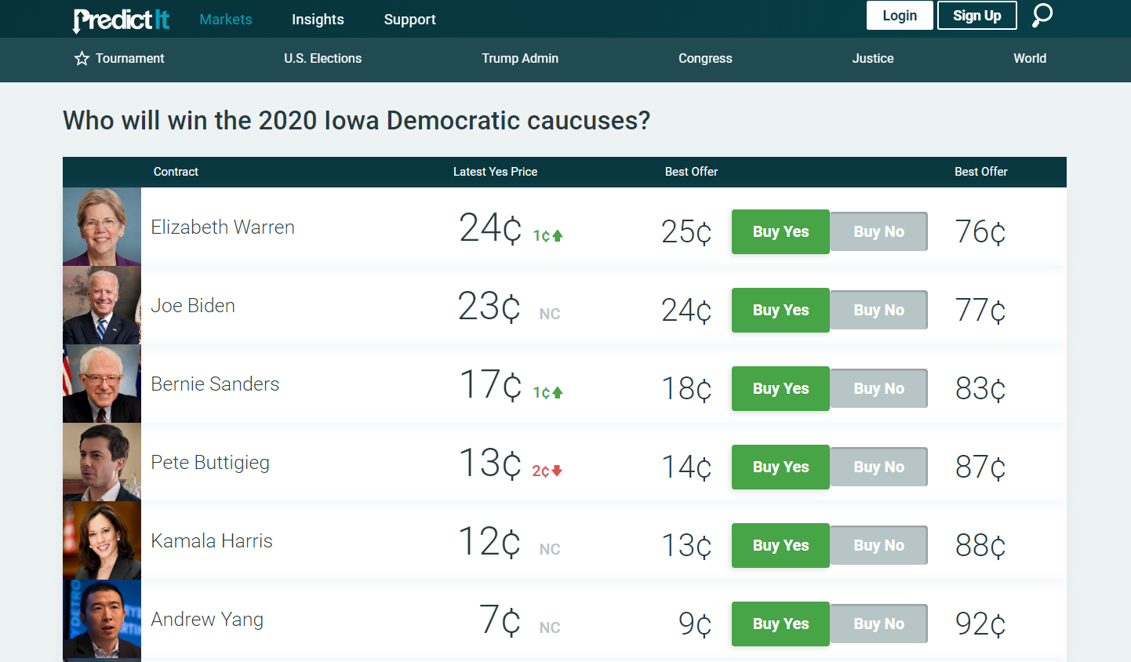
What is Predictit.com?

Slide 3


Objective of Project
To see if user comments can be used to effectively predict the trading activity on Predictit.com

Slide 4
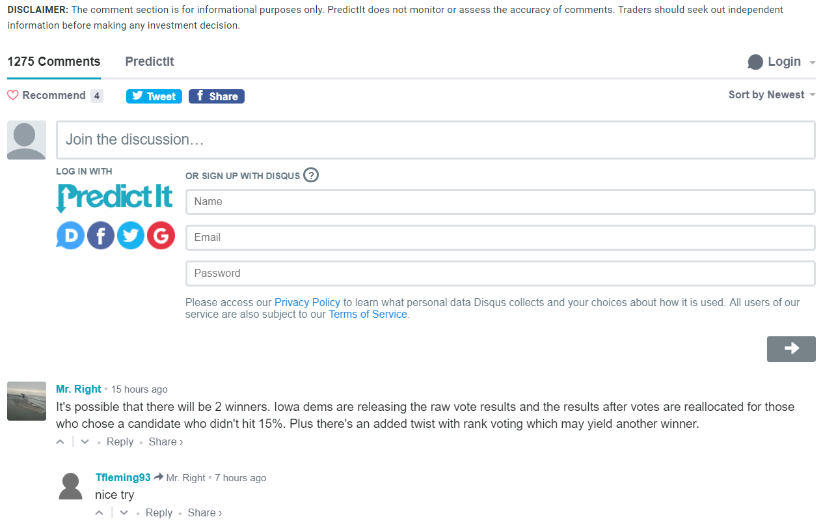
The Data
Over 1200 comments made in the “Who will win the 2020 Iowa Democratic Caucuses market”

Slide 5

Process of Scraping Data
Needed to account for the Iframe
What to do with imbedded comments (e.g. youtube videos, twitter etc.)
Need find info on date comment made rather than the age of the comment

Slide 6
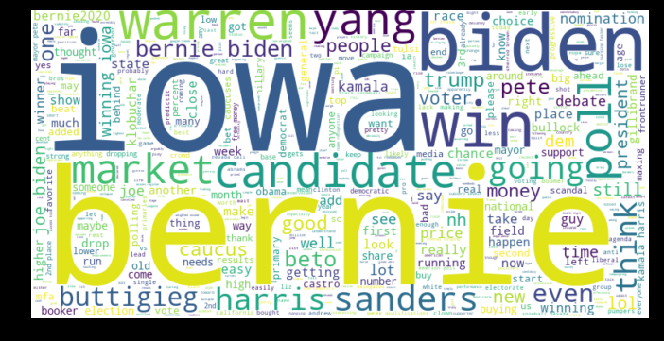
What did we find?

Slide 7
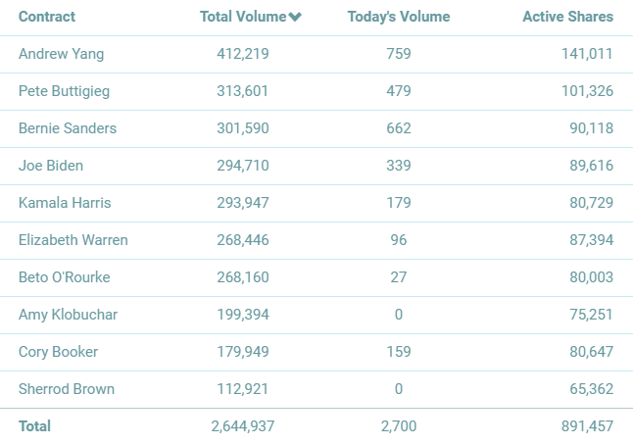
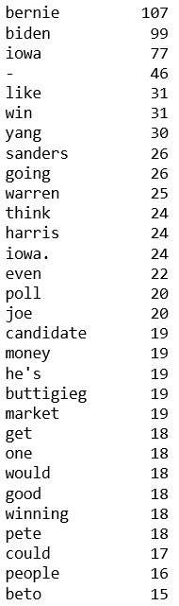
Who’s Popular?

Slide 8
Relation between trading and comments

